Slide 1

Real World Usecase RETREIVAL AUGMENTED GENERATION (RAG)
watsonx.ai

Slide 2
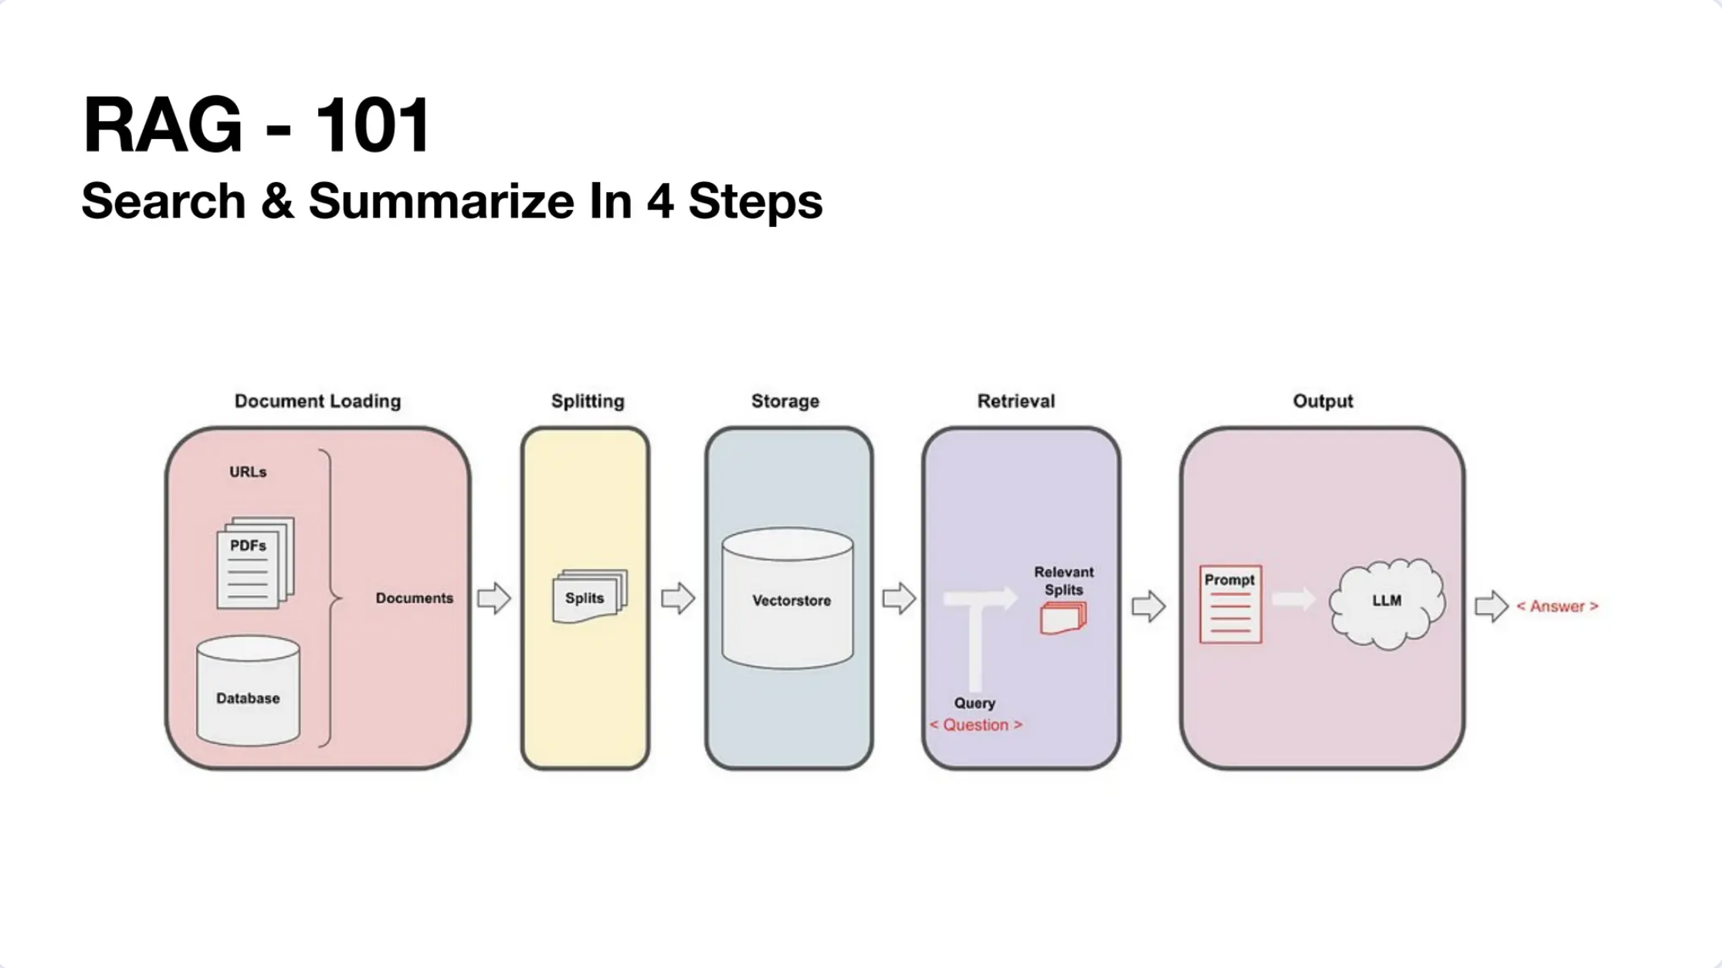

Slide 3
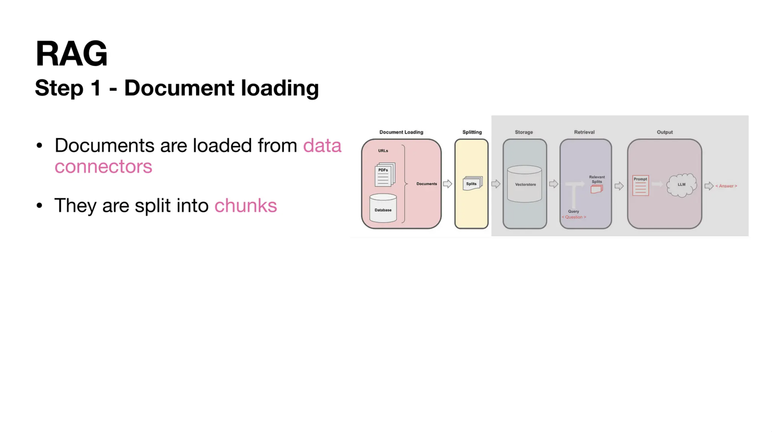

Slide 4
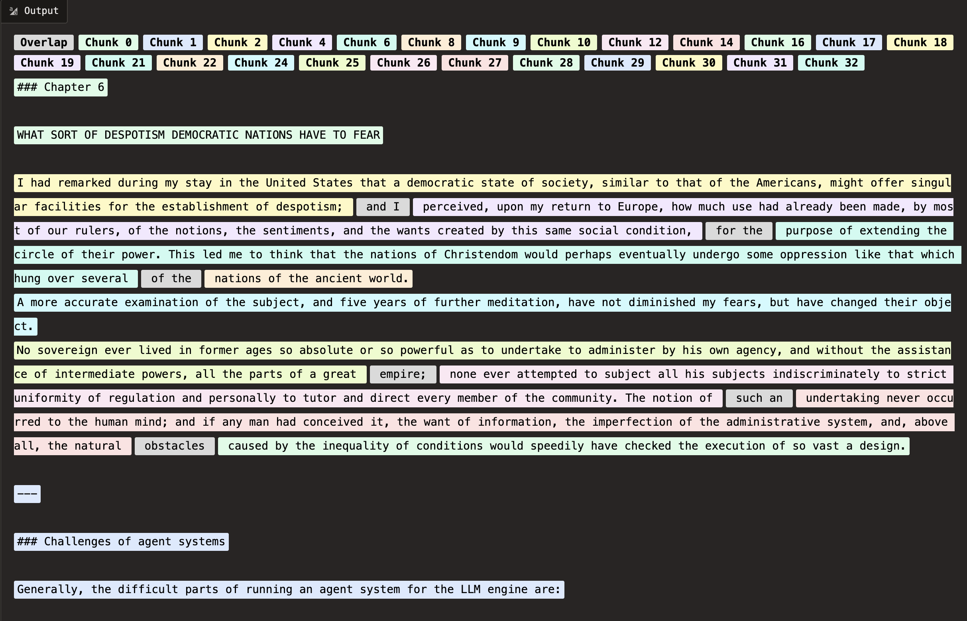
Chunking

Slide 5
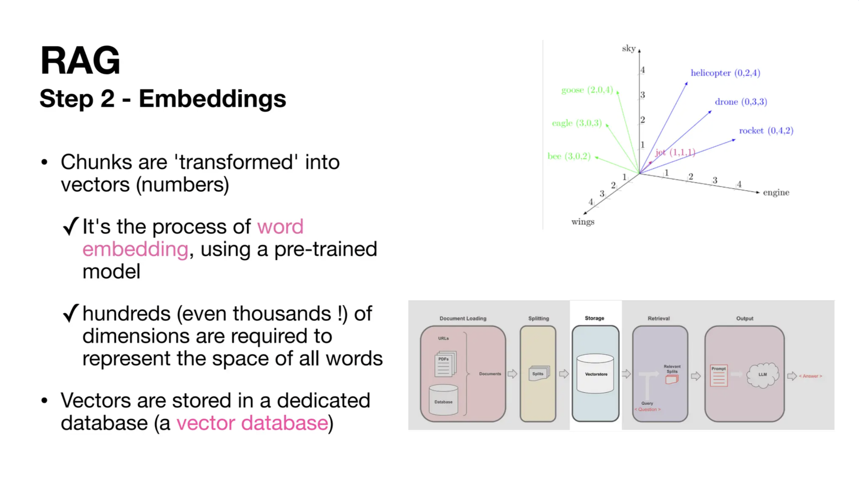

Slide 6
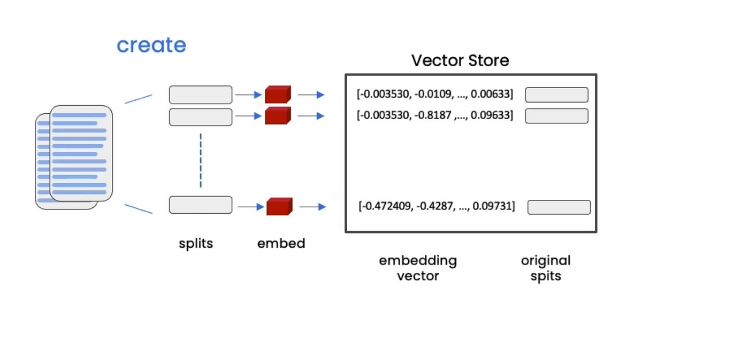
Embeddings
Notes:
Use as supporting material if needed with the client to go deeper into Tuning Studio details around prompt tuning techniques and roadmap

Slide 7
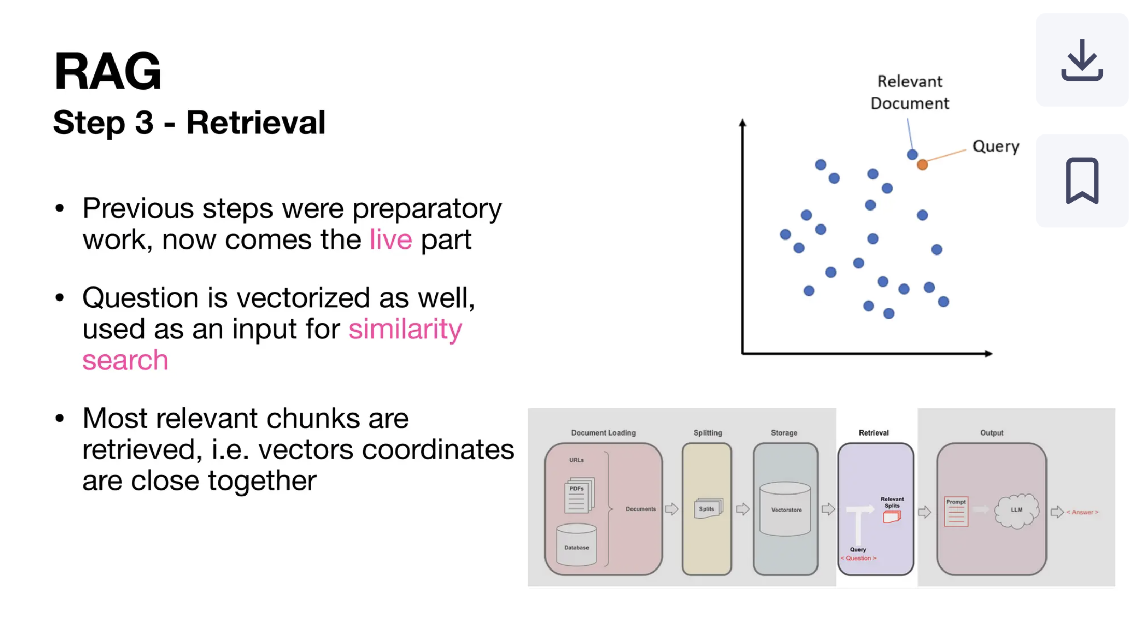

Slide 8
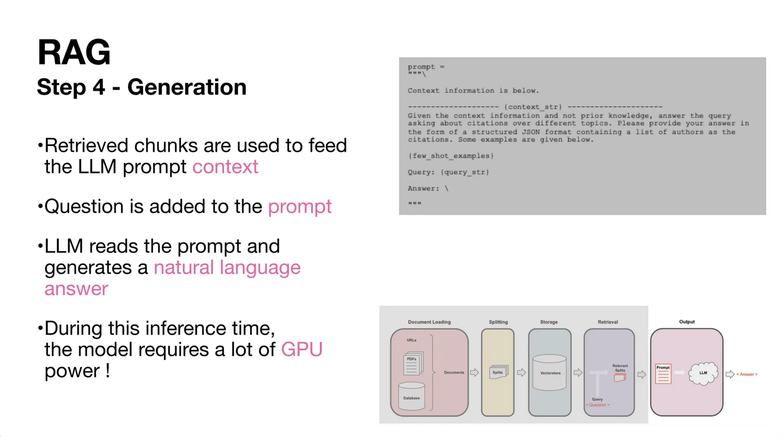

Slide 9


